Slide 1
Quest Hunt
Rajashekar Gande
Ravichander Reddy

Slide 2
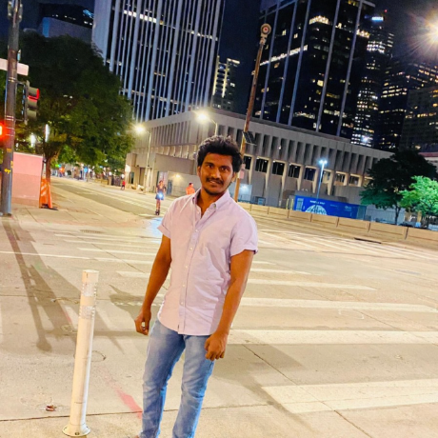
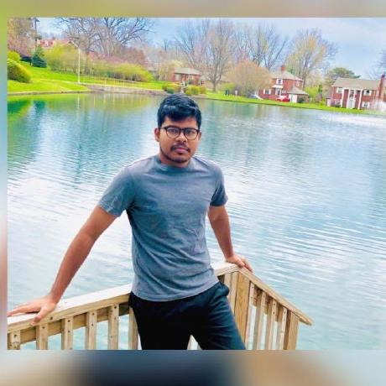
About Us:
Rajashekar Gande
https://github.com/Rajshekar2641
Ravichanderreddy Goli
https://github.com/Ravichanderreddy-goli

Slide 3
Objective
To understand the full stack application development
Playing a quest game where it has two colors
When the user touches the first color, the quest location would be ready.
And by touching the second color, the user gets information whether they have reached the quest.

Slide 4
Technology Stack
Front end: ReactJS
Database: MongoDB
Backend: ExpressJS
IDE: VSCode
Platform: Web Application
Deployment: Heroku
Environment: Nodejs

Slide 5
Published App
App deployed on Heroku
https://questhunt-frontend.herokuapp.com/

Slide 6
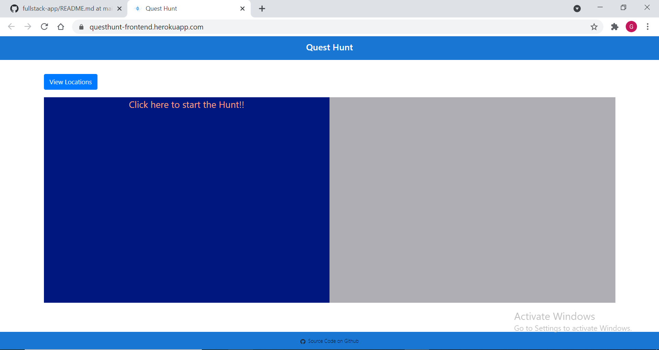
App Screenshots

Slide 7
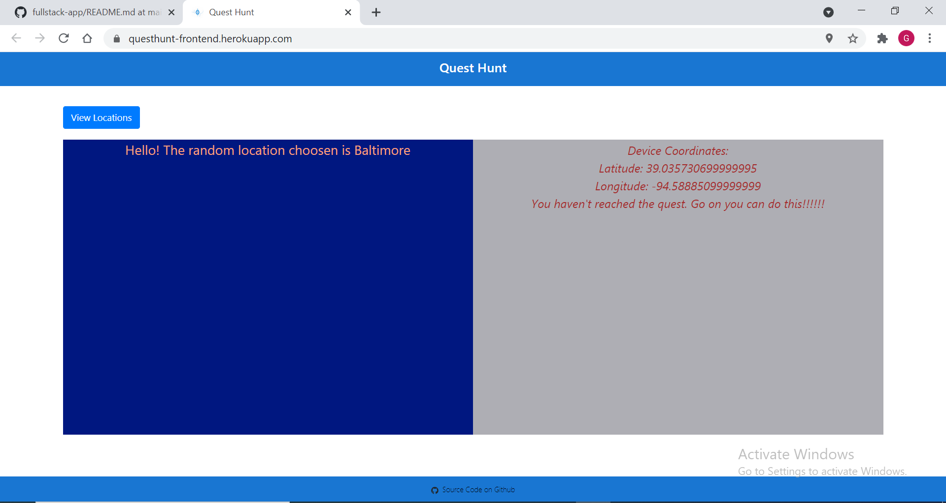

Slide 8
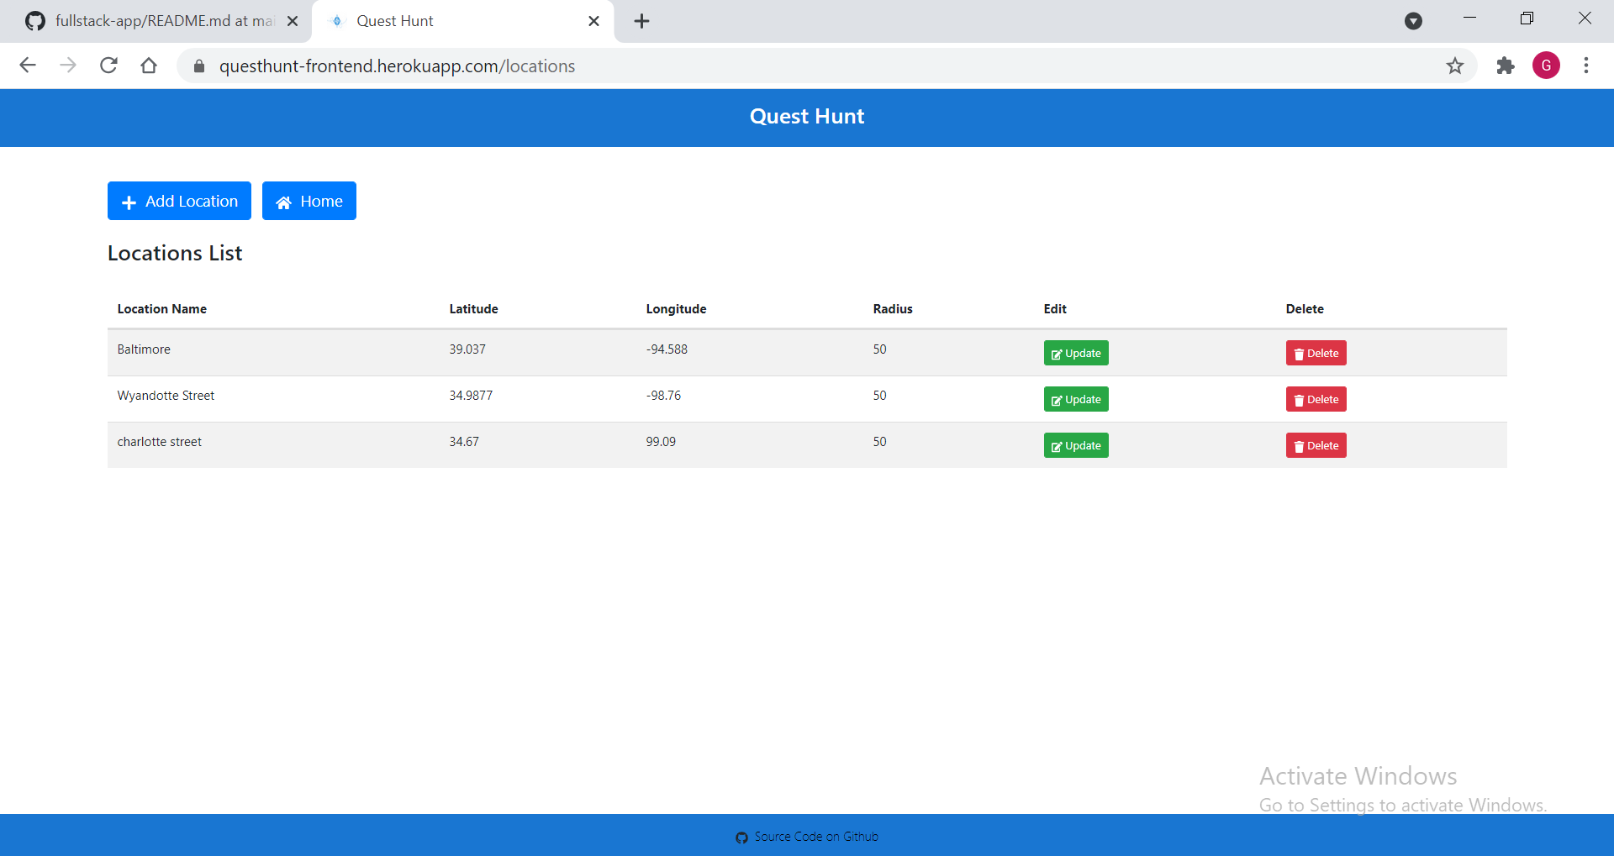

Slide 9
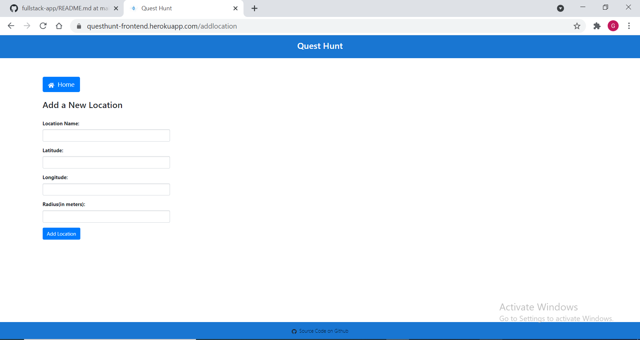

Slide 10
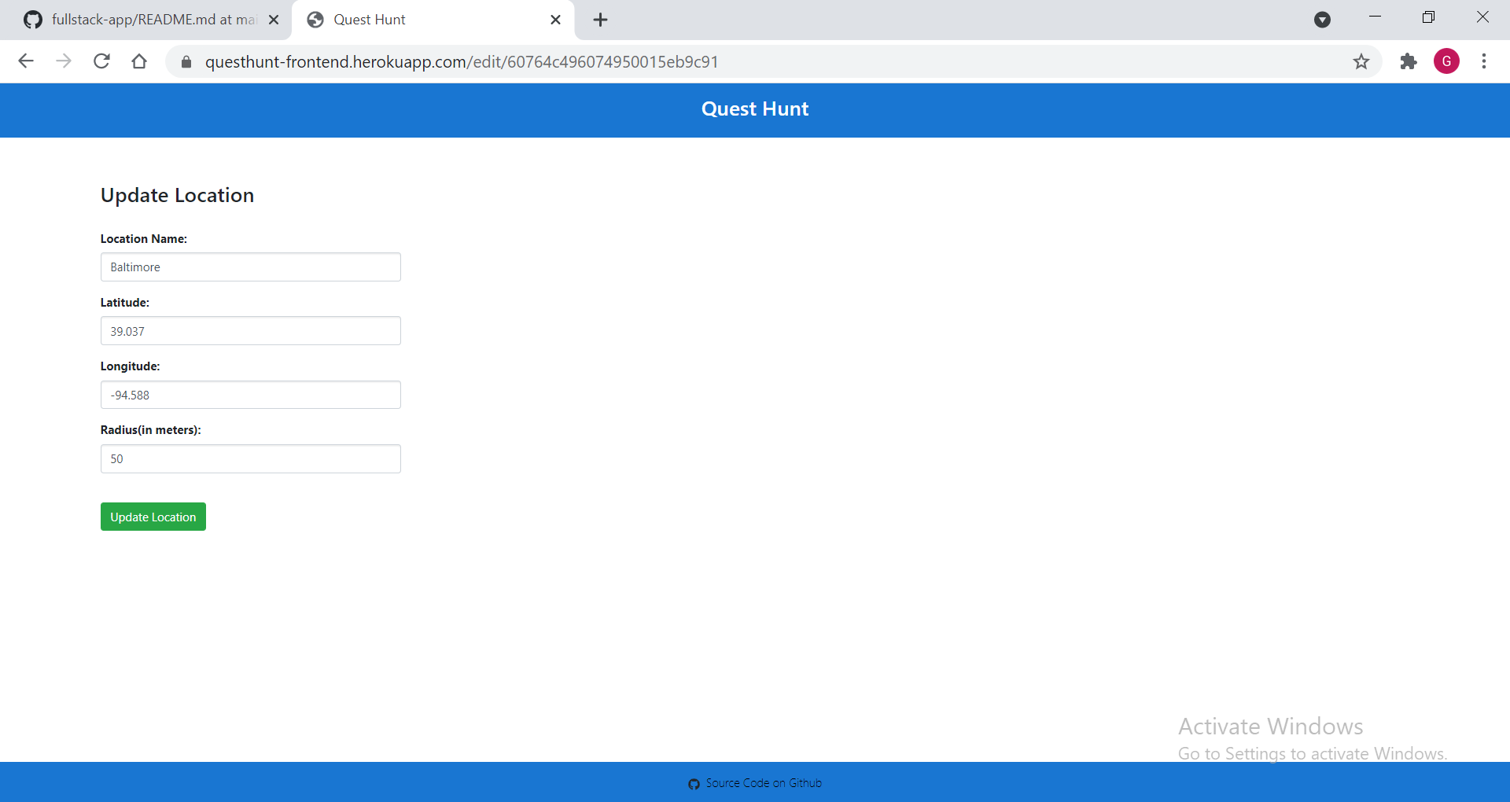

Slide 11
